Slide 1


Introduction to Microscopy
Tom Zimmerman
IBM Research-Almaden
Center for Cellular Construction
Sept 2, 2021
This material is based upon work supported by the NSF under Grant No. DBI-1548297.
Disclaimer: Any opinions, findings and conclusions or recommendations expressed in this material are those of the authors and do not necessarily reflect the views of the National Science Foundation.

Slide 2
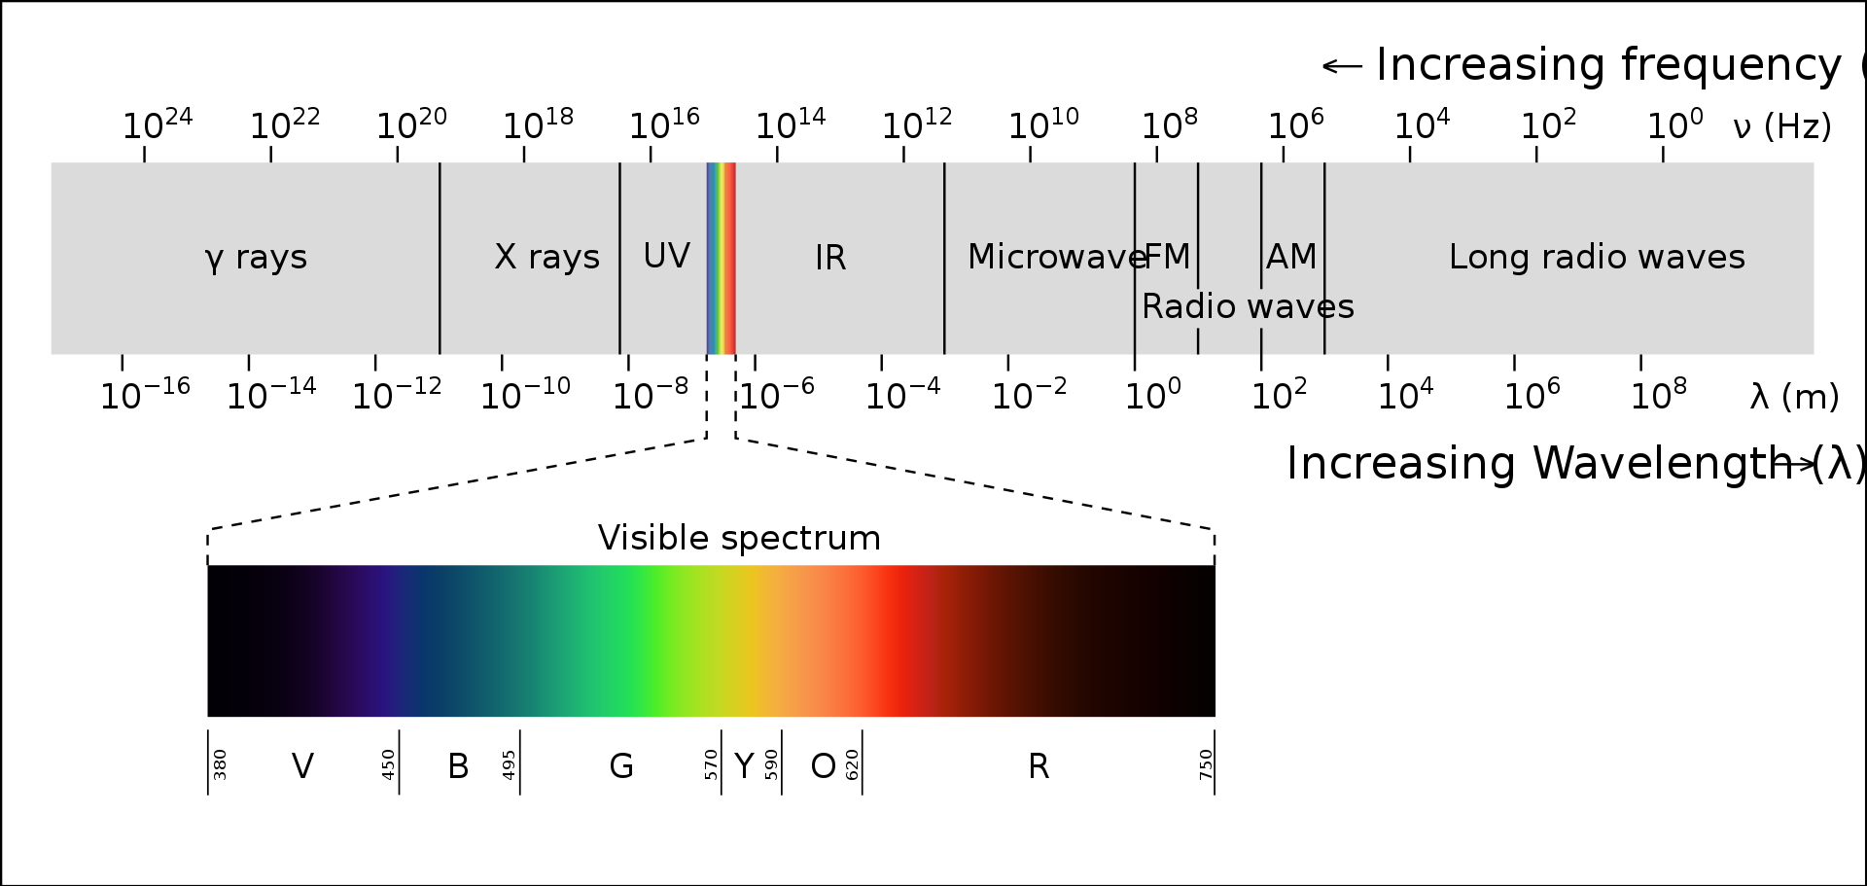
Electromagnetic Spectrum
Light or visible light is electromagnetic radiation within the portion of the electromagnetic spectrum that is perceived by the human eye

Slide 3
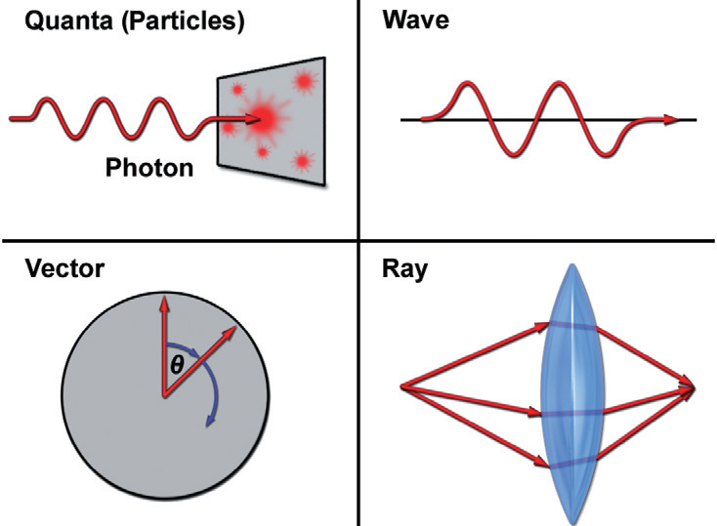
c = freq*wavelength
Energy = PlanksConstant*freq

Slide 4
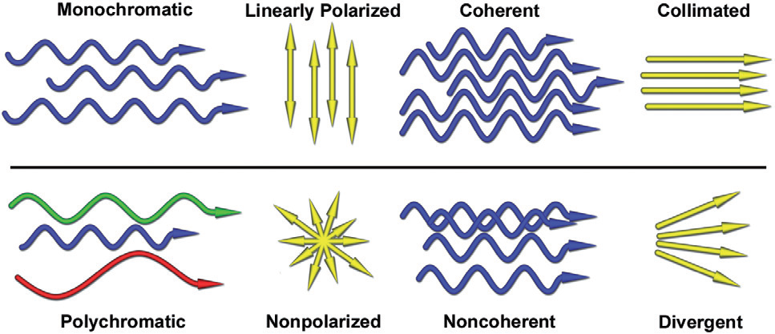
Types of Light
E vectors vibrate in parallel planes
Same phase
Coaxial
Same wavelength

Slide 5
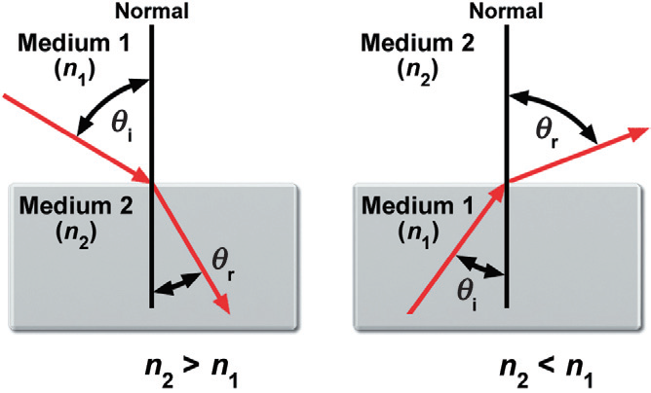
Refraction & Snell’s Law

Slide 6
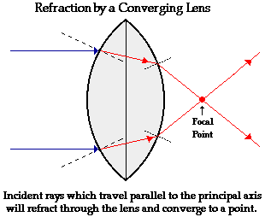
https://www.physicsclassroom.com/class/refrn/Lesson-5/Refraction-by-Lenses

Slide 7
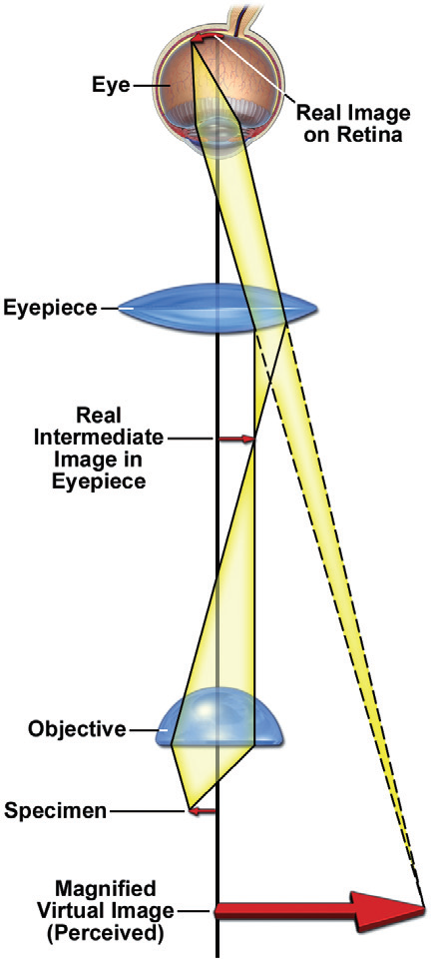
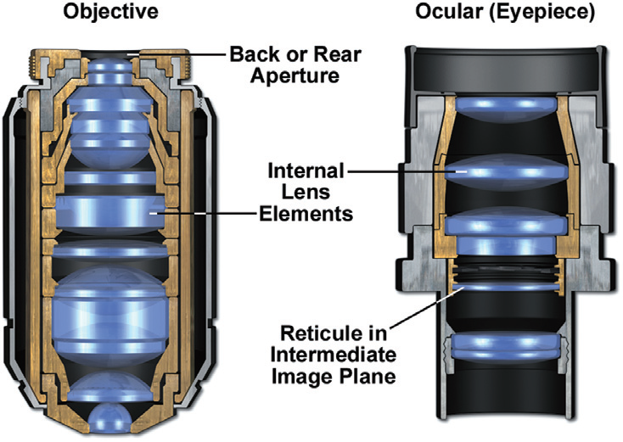

Slide 8
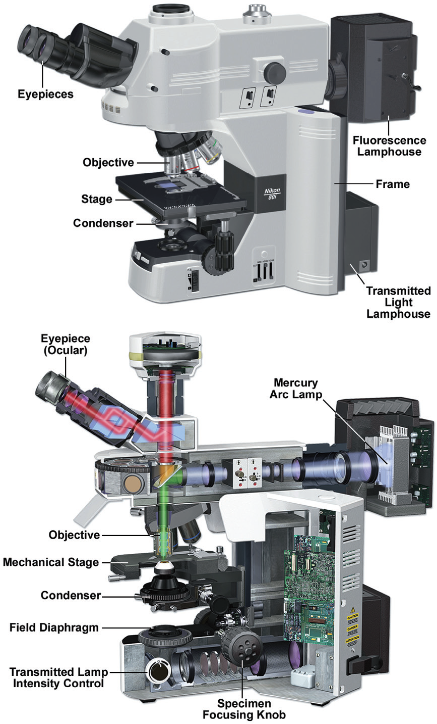

Slide 9
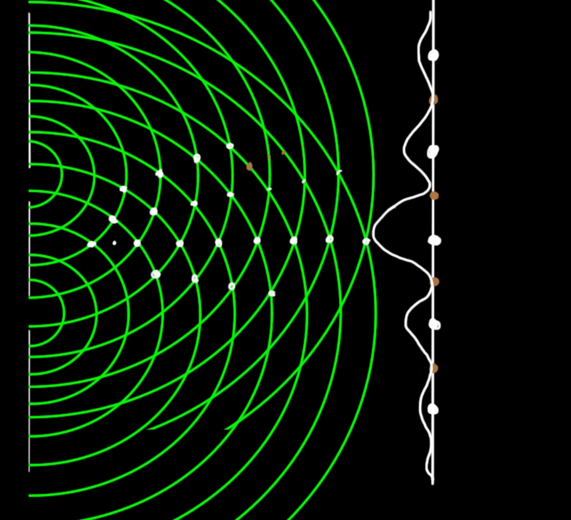
Young’s Experiment (1801) Double Slit Experiment

Slide 10
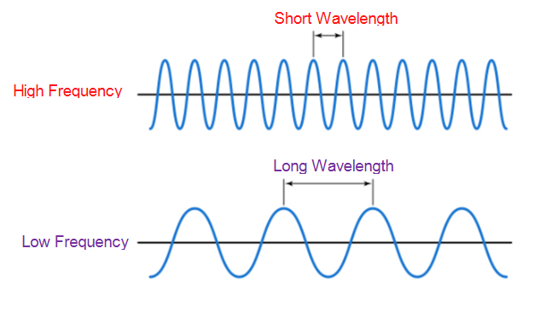
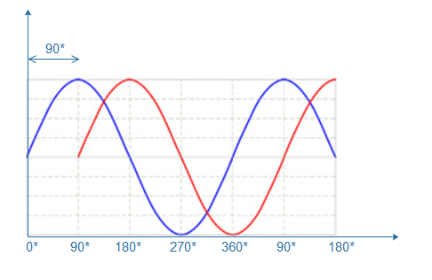
phase

Slide 11
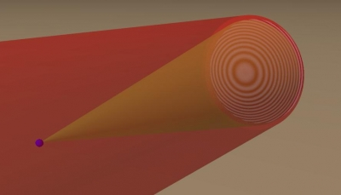
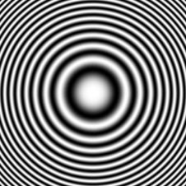
Creating Hologram of Point Object
Image Sensor
Reference Beam
Interference Pattern
LASER
Subject Beam
Subject
(point)
Z
Fresnel Zone Plate
https://github.com/manoharan-lab/holopy
Manoharan Lab, Harvard
https://holopy.readthedocs.io/en/latest/users/index.html
https://manoharan.seas.harvard.edu/holographic-microscopy

Slide 12
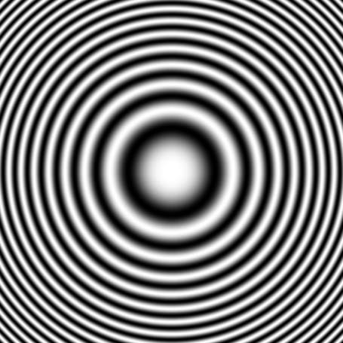
Reconstruction with Laser
Laser
Reconstructed
Subject
Photographic Film of Interference Pattern
(Fresnel Zone Plate for point source)

Slide 13
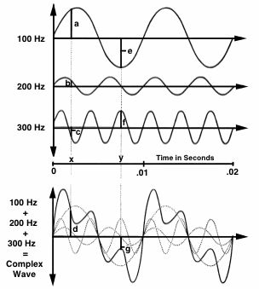
Fourier Analysis & Synthesis
Any time-varying (complex) sound can be analyzed to find its frequency components.
Any complex wave can be constructed by adding together sine waves of appropriate frequency, amplitude, and phase.
https://hearinghealthmatters.org

Slide 14
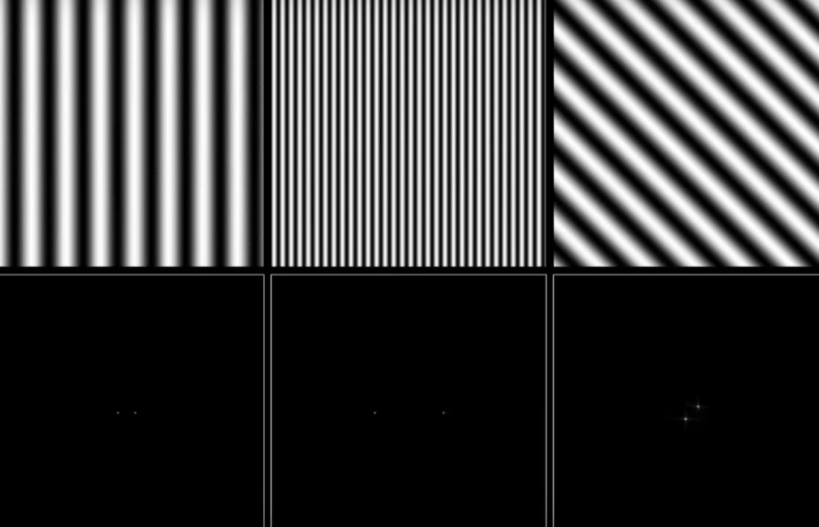
https://youtu.be/gwaYwRwY6PU

Slide 15
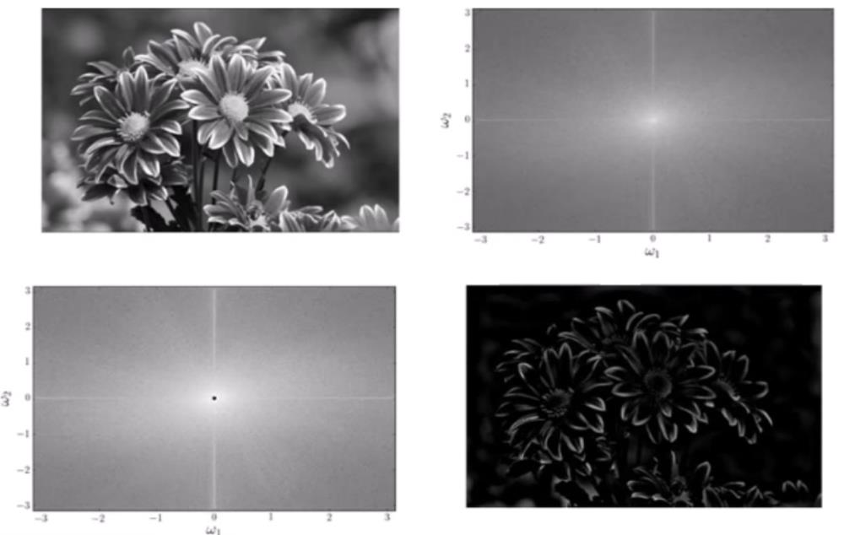
High Pass Filter
https://youtu.be/oACegp4iGi0

Slide 16
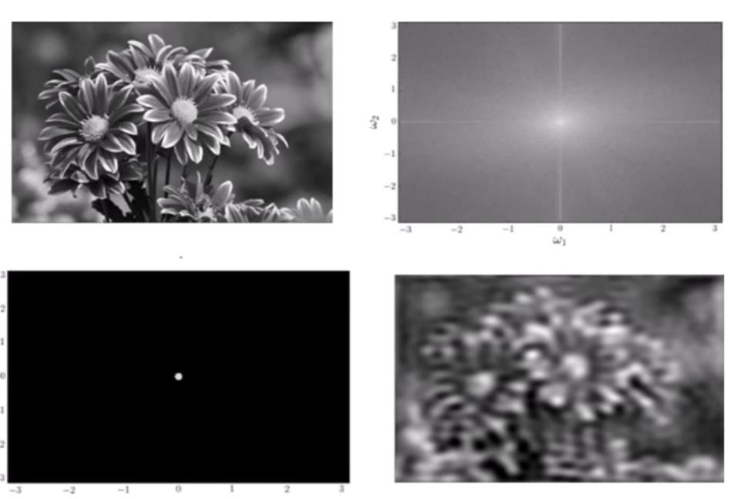
Low Pass Filter
https://youtu.be/oACegp4iGi0

Slide 17
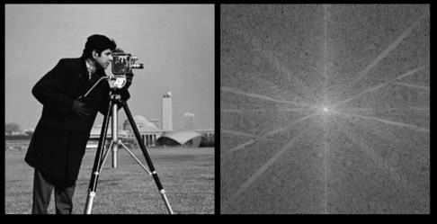

Image of “cameraman” Copyright MIT

Slide 18
Laser
Cap
PVC card
Glass Slide
Hinge
Image Sensor
Printed Circuit Board (PCB)
Potentiometer
Raspberry Pi Zero

Slide 19
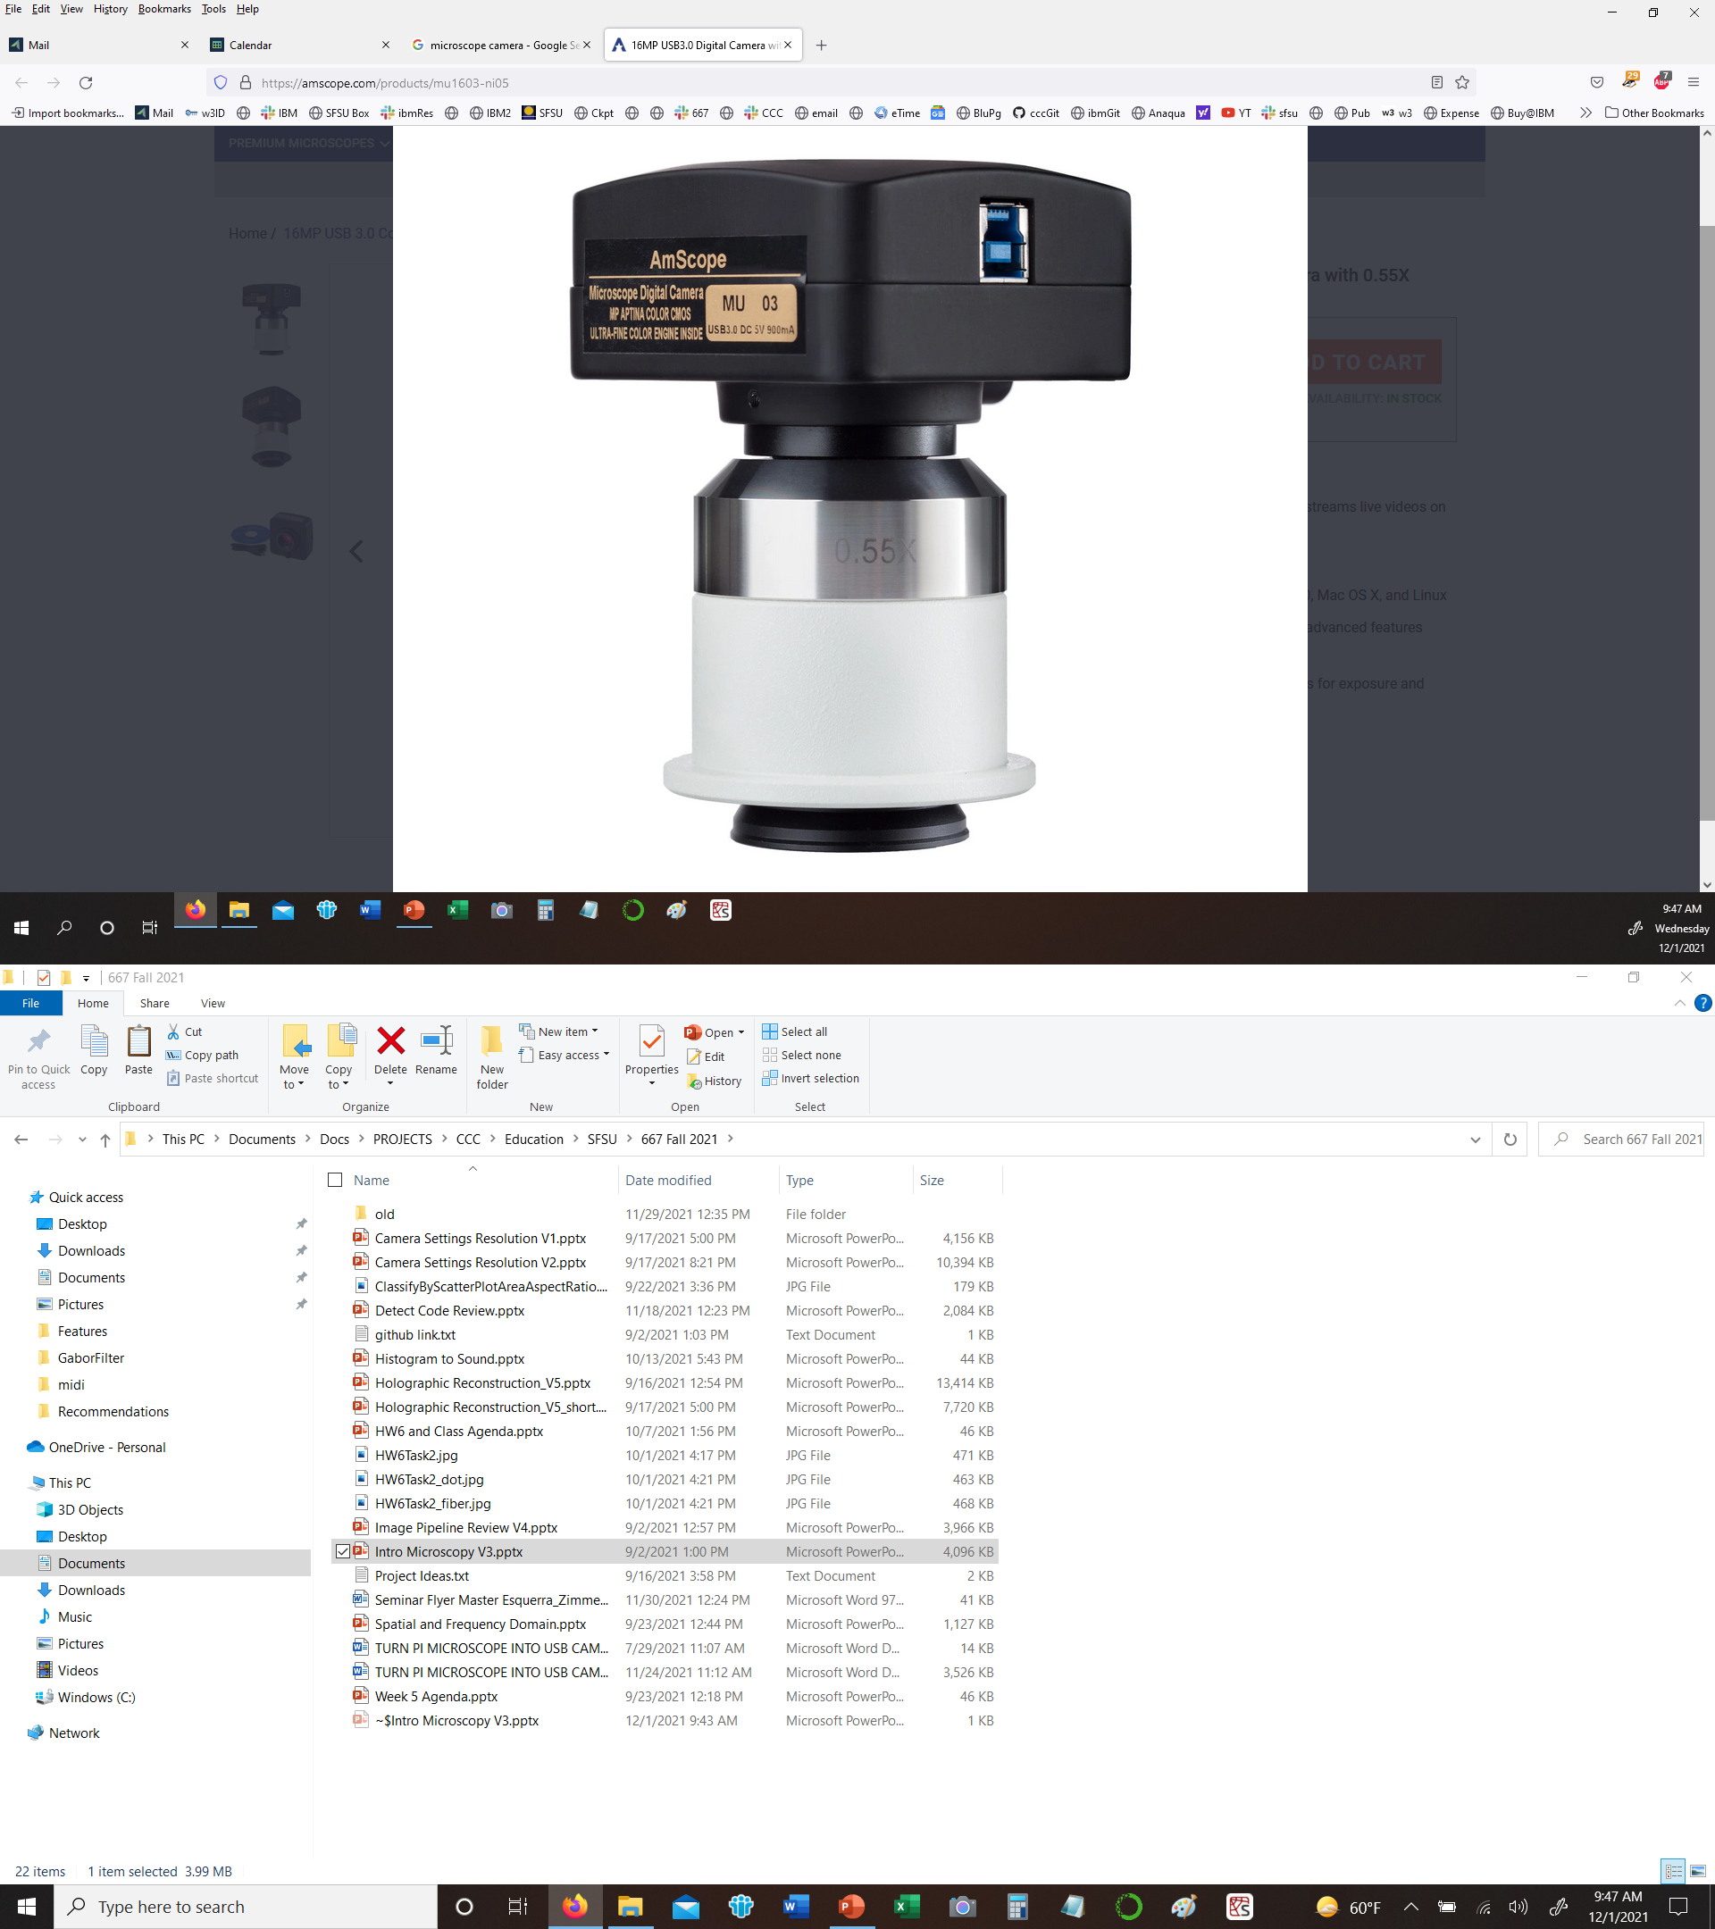
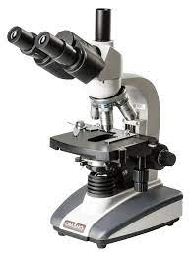
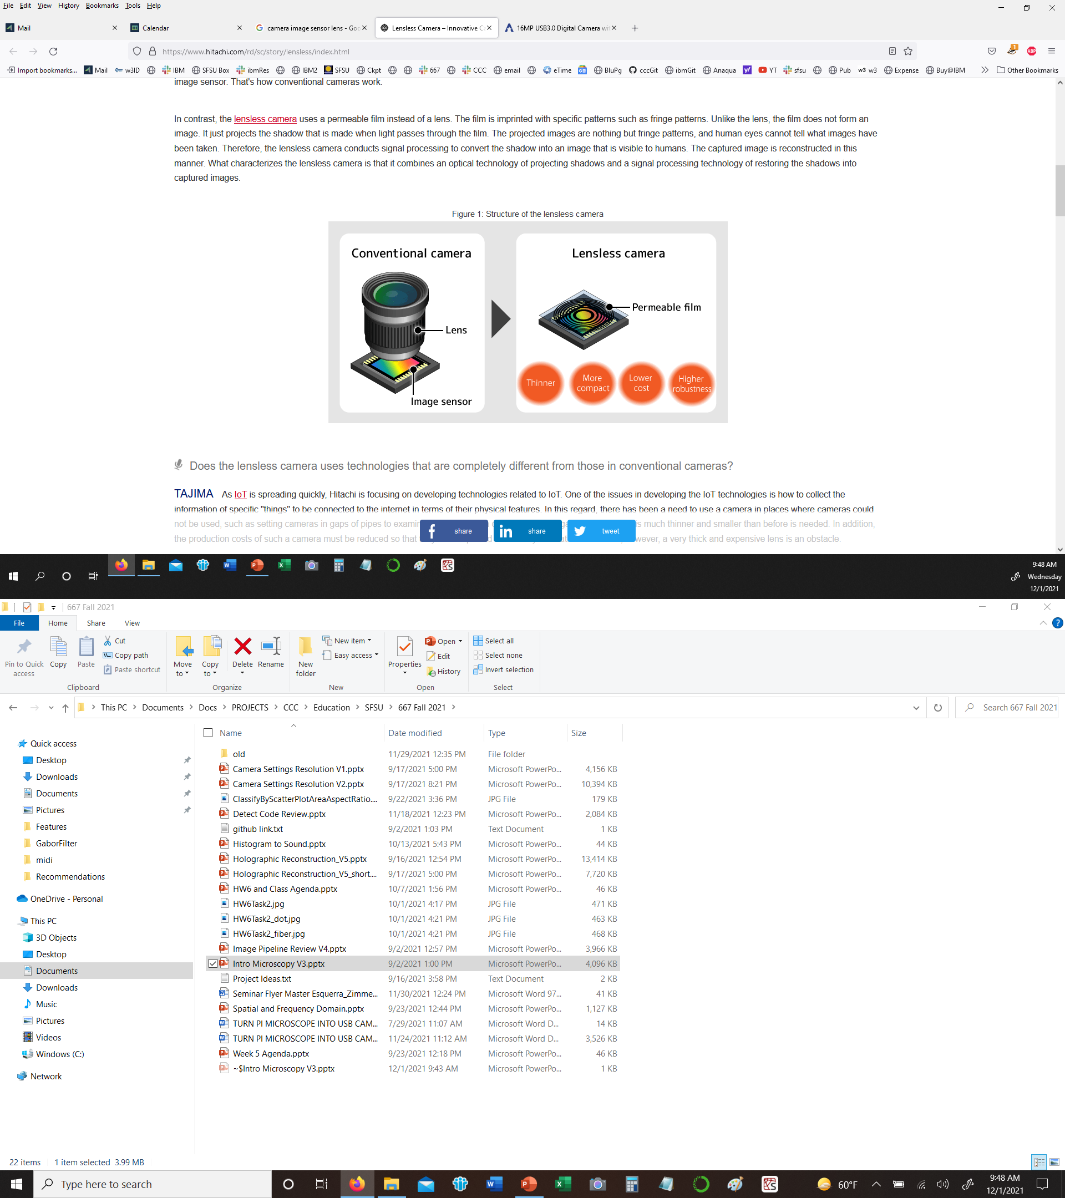
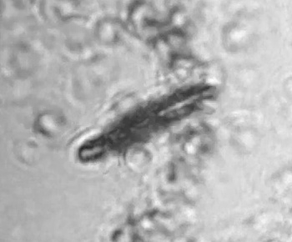
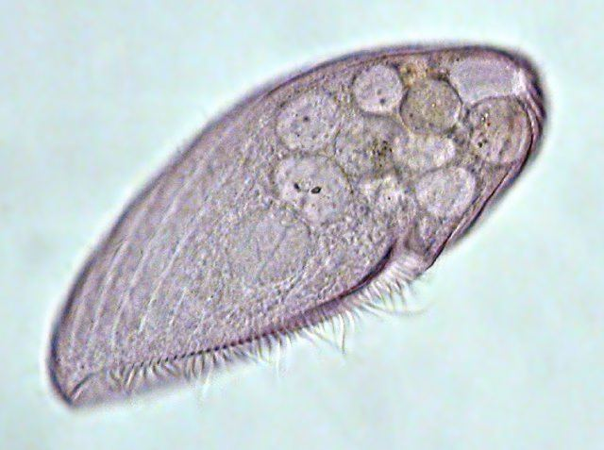
Optical Microscope Camera Lensless Microscope
Camera
Point
Light Source
(Blue LED)
Z
Image Sensor
diffraction

Slide 20
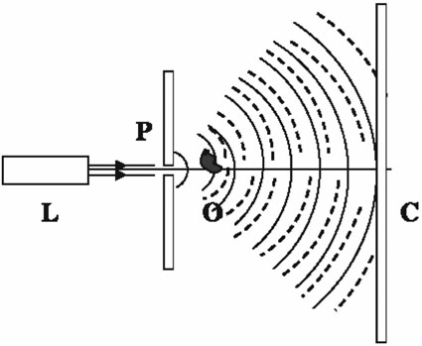
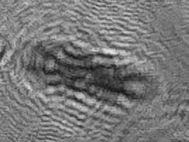
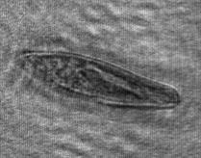
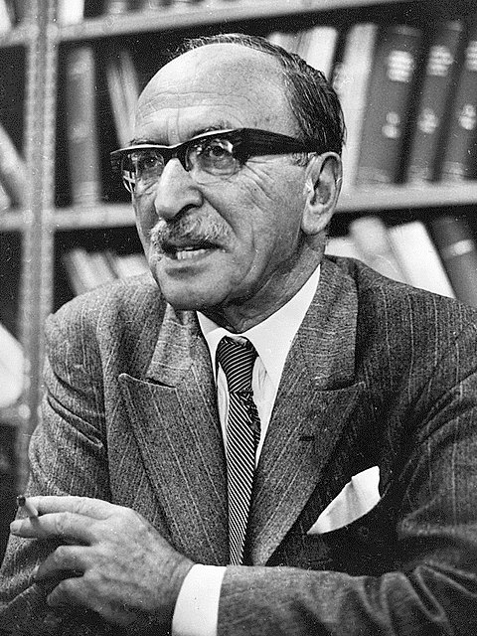
Microscopy by Reconstructed Wave-fronts
D. Gabor, 1948
Direct In-Line
Holographic Microscope
Laser
Coherent
Light Source
Pinhole
Reference Beam
Object Beam
Solid=Reference
Dashed=Object
Za
Z
Zb
Digital Image Sensor
Photographic Film
Original Hologram
Reconstructed Image
Fringes
376 um
Paramecium
Denis Gabor (1900-1979)

Slide 21
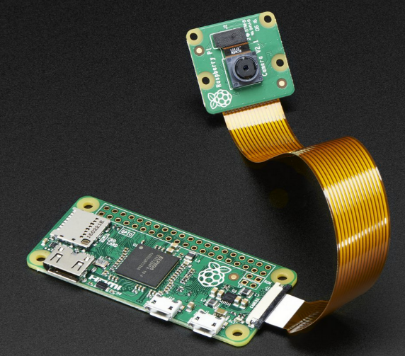
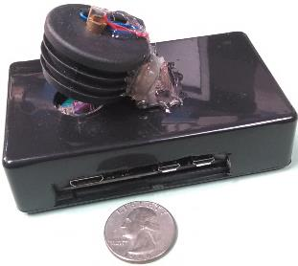
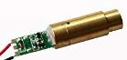
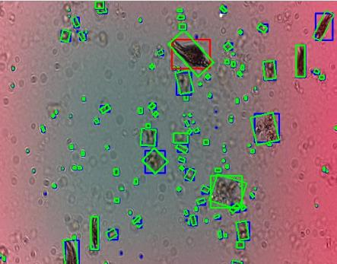
Raspberry Pi ZeroW $10
Image Sensor $5
Laser Module $0.30
5 Mpix Image Sensor
1080p Video 30 FPS
3.7 mm x 2.7 mm
1.4 um pixel
Laser
Sample Slide
Image Sensor
Raspberry Pi

Slide 22

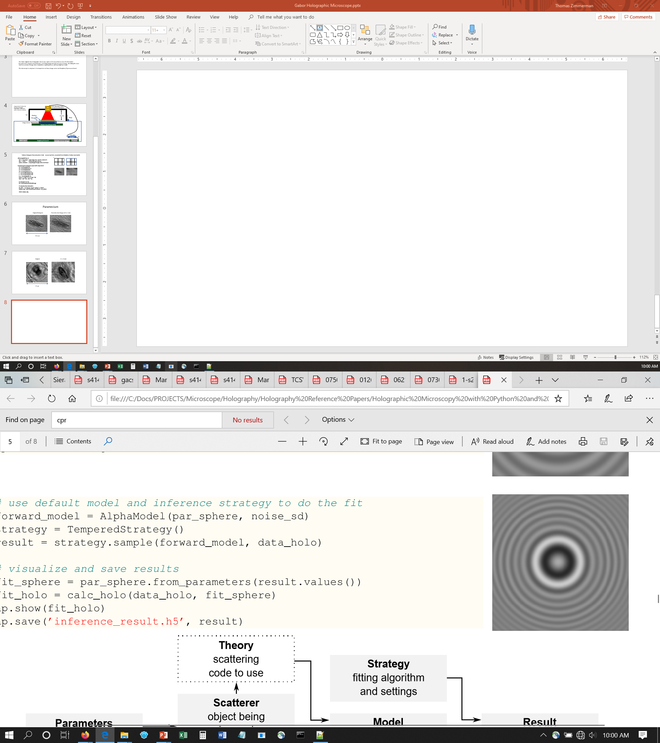
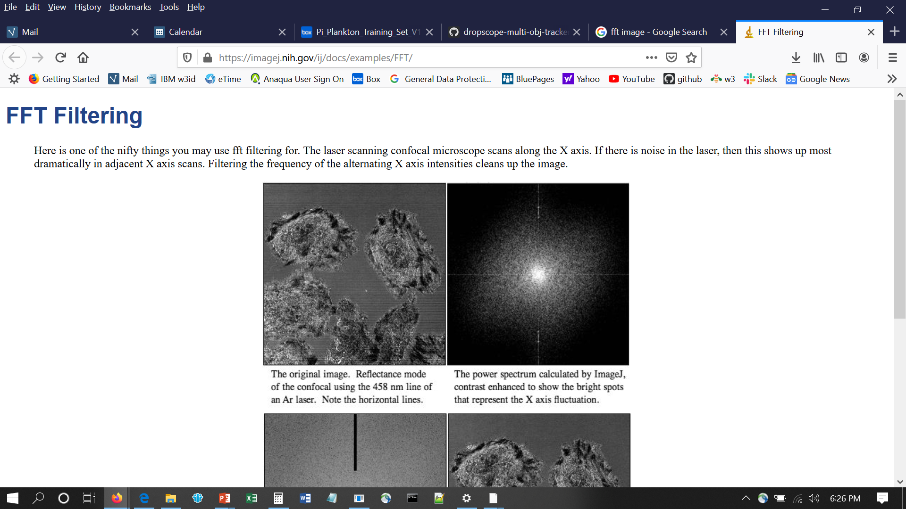
Direct In-Line Holographic Microscope
Original Hologram
Reconstructed Image
Fringes
376 um
Paramecium
Microscopy by Reconstructed Wave-fronts
D. Gabor, 1948
Pixel, Z
Wavelength
FFT
Coherent
Light Source
Pinhole
X
Solid=Reference
Dashed=Object
Inverse FFT
Z
Photographic Film

